Slide 1

MYSTORE WEB APPLICATION mini project 1
GARRY M. CACHO, 44yo
An Electrical Engineer by day, and a C++ programmer by night
www.garrymcacho.com
Notes:
Good day everyone, specially to all the panelist and kapwa kodegeeks thank you for granting the time to be here. I am glad to present to you the output of mini project 1 which I entitled myStore Web Application. By the way, I am Garry Cacho, 44yo, married for 11years and a father of a 3 year old girl. I am still learning to climb this steep ladder to become a full pledge web developer in the near future.

Slide 2
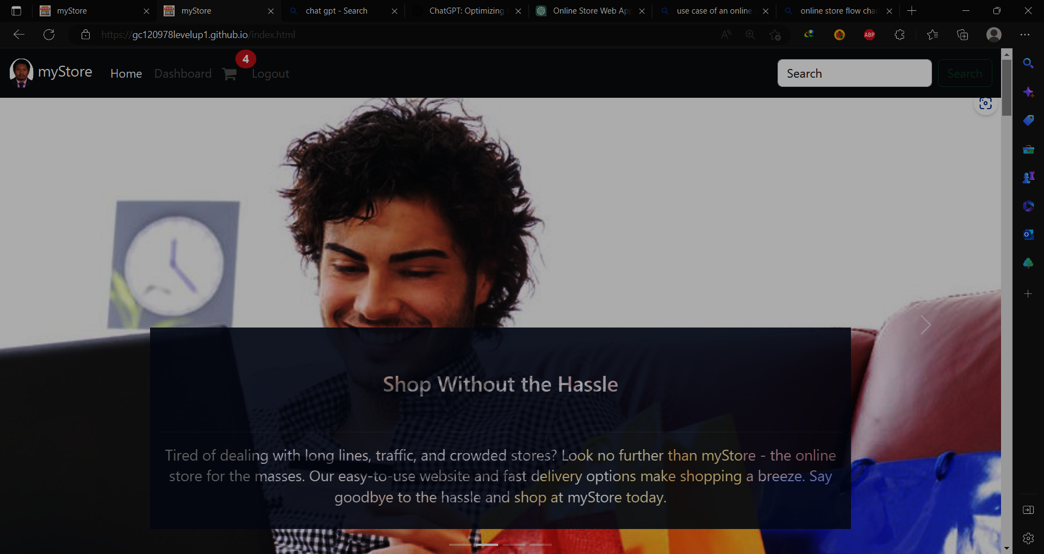
AGENDA
Brief Introduction​
Objectives
Scope and Limitations
Technologies
Use Case
Object Models
Data Flow Diagram
Road Map​
Summary
Notes:
For this presentation related to mini project 1, I prepared 9 short basic agendas to tackle in order to fully explain the inner workings of myStore Web Application.
We have a short introduction, objectives, scope and limitations, technologies being utilized, use case diagram, object models, Data Flow Diagram, road map and last but not the least Summary.
I expect many questions and corrections along the way. I am glad to absorb it so that I can improve my little skill in web development.

Slide 3
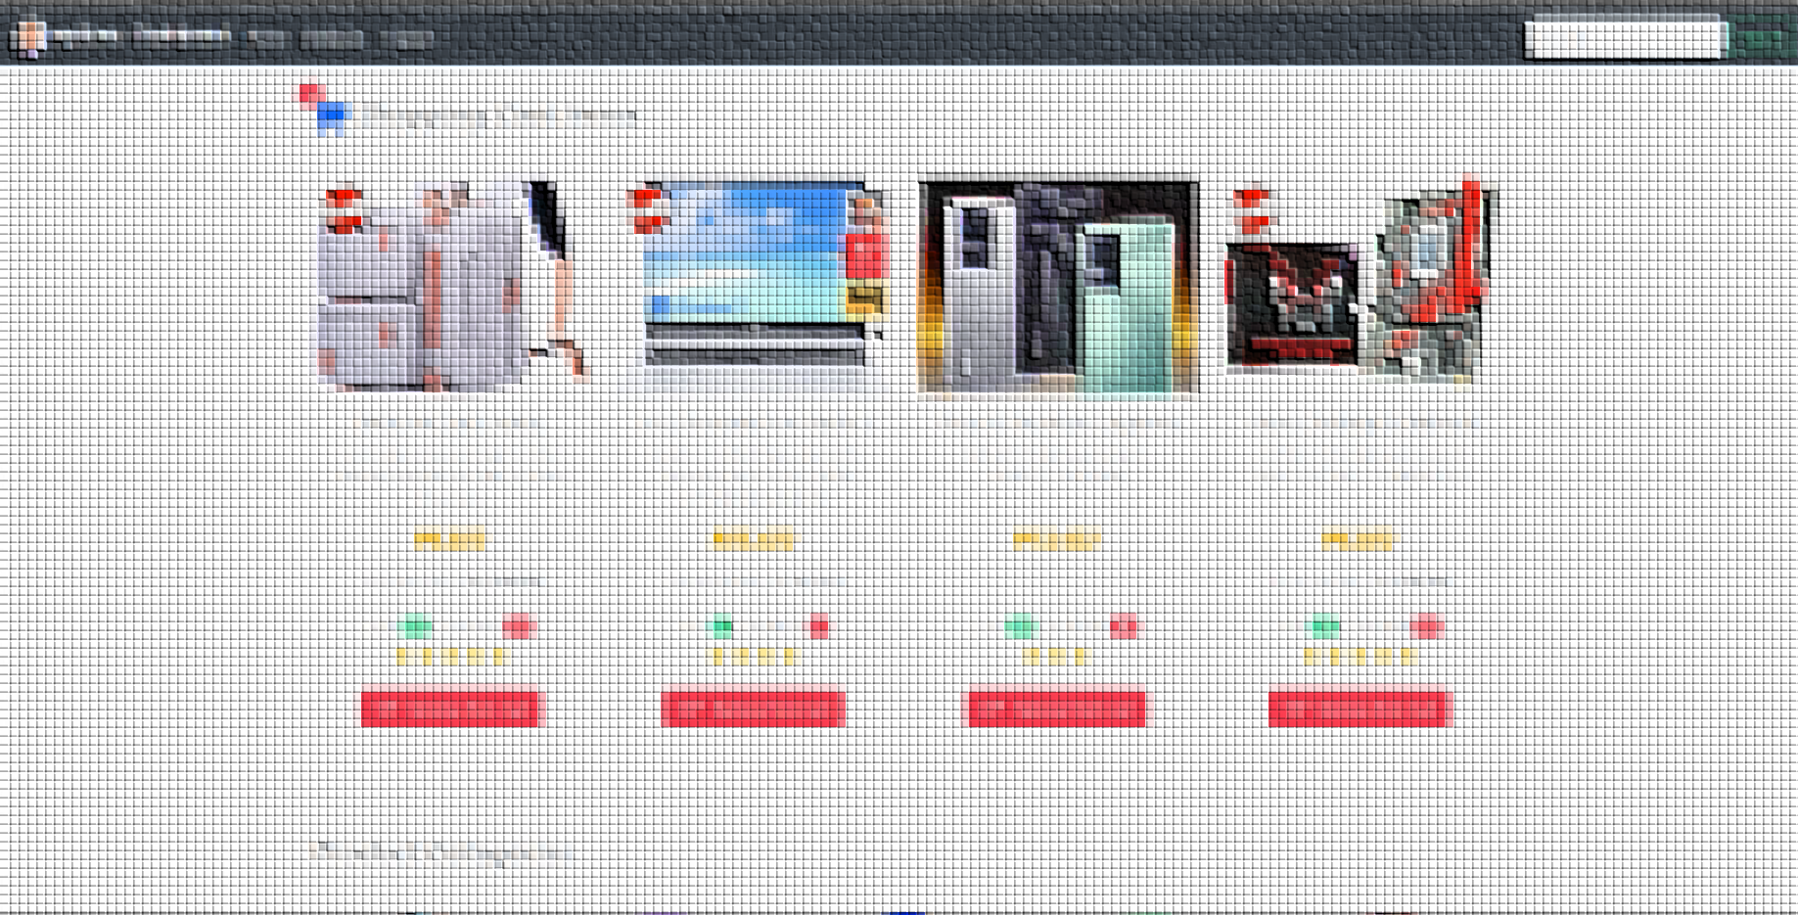
Brief Introduction
Notes:
Introduction

Slide 4
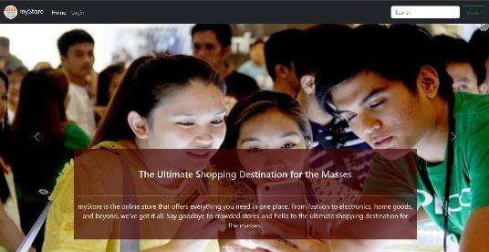
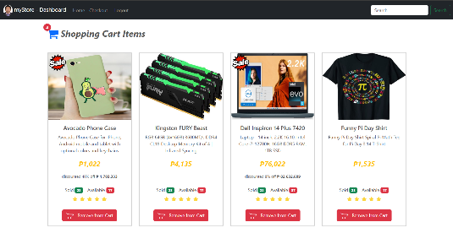
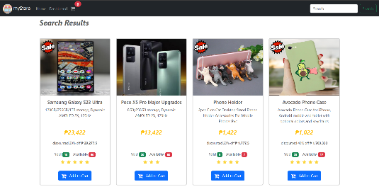
Modern and user-friendly online store web app
Mobile responsive design, accessible from any device.
Advanced product item search and filtering function
Notes:
myStore Web Application, is a mock implementation of a basic and simple online shopping web app with emphasis to user-friendliness, modern look and simplicity
Due to the use of bootstrap framework introduced by our very helpful and inspiring mentor sir Wendell, I was able to implement responsive design that enable the web app to be viewed
With many device shape and sizes.
It has also basic product search features, that enables the user to query the desired product using a search string., this was possible due to the introduction of array filter function.

Slide 5
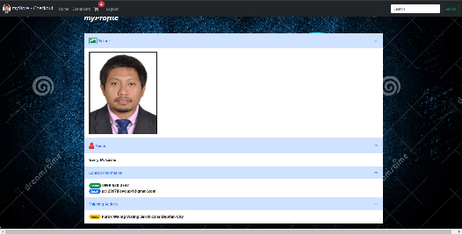
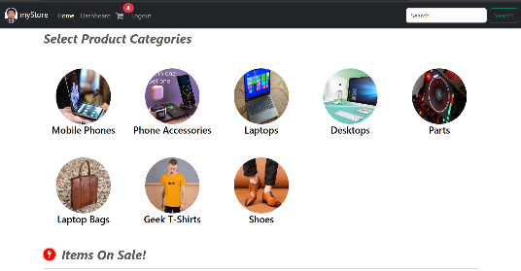
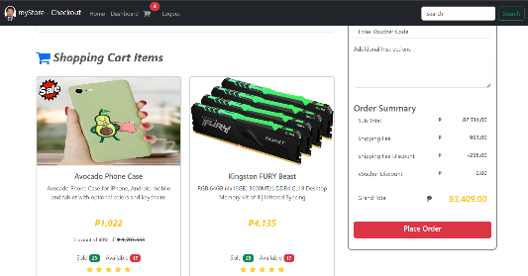
The web app has sign up, login, logout and user info features
Simple product categorization to make the app less cluttery
Clear representation of shopping cart and checkout
Notes:
Additionally, a basic security features is also implemented that enable multiple users to login and log out of the system.
And in order To simplify the products presentation, products are grouped into categories of similar properties so that whenever the user may opt to select a limited list of products, it would be easy for the user to browse few number of list.
It has also shopping cart and checkout mechanism, whereby the user before opting to buy any product, it first store the selected products in a shopping cart and the total amount will be seen during checkout

Slide 6
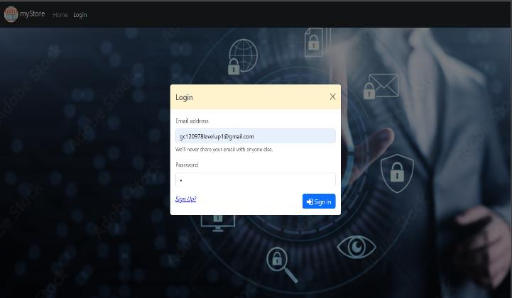
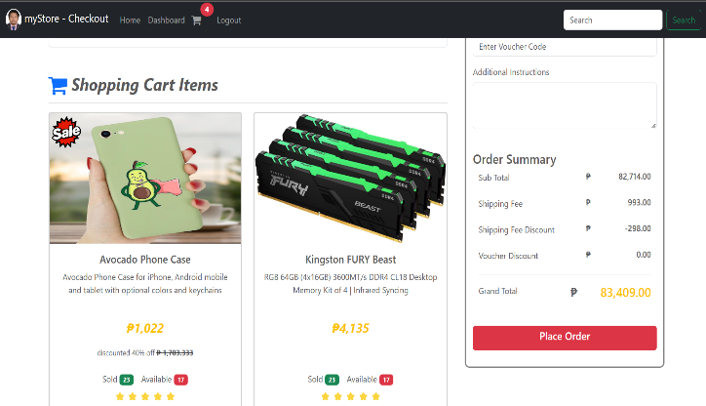
Objectives of the project
To demonstrate our newly learned skills in modern web page design and implementation
To create a proof of concept on how to implement a simple online web app
Notes:
The objective of the project is to
Basically this system is only to showcase our newly acquired skills in implementing web page design
An to create a proof of concept on how to implement the visualization, logic and data flow of a simple online shopping web application.

Slide 7
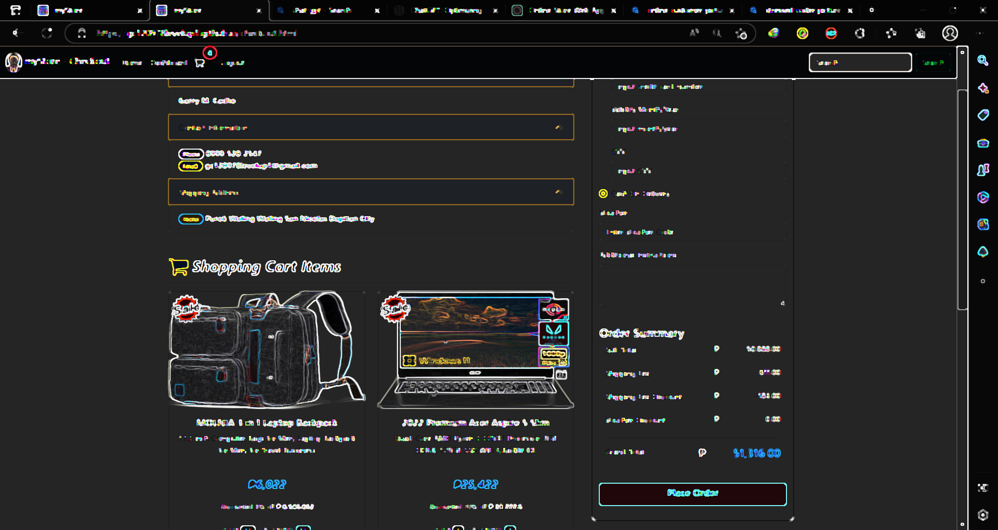
Project scope and limitation

Slide 8

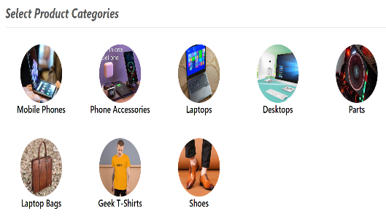

scope
Implementation of a static web application facing the client customer.
Client selection of products categorized initially into 8 groups
Enable the Client to place the product on a shopping cart and perform checkout
Notes:
The basic objective of this project is to create a static only web app that caters the necessities of a customer/client facing web application where the user can be able to login and logout, view products, add products to shopping cart, perform a checkout, opt for a mock payment transaction and view upcoming purchased delivery list

Slide 9

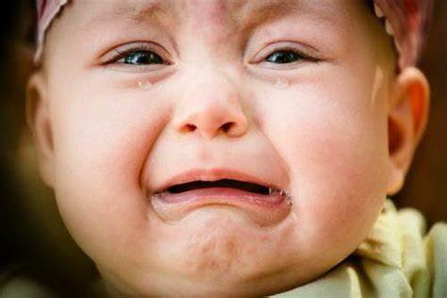

limitations
All data used are static therefore user transactions will not be able to permanently save.
Monitoring of status for incoming product deliveries is not implemented
New user Registration form is implemented but not functional
Notes:
Due to the static nature of the web application, all transaction data is not saved permanently using database.
The list of purchased products can be viewed be default, however the step by step status of delivery schedule of each product is not implemented due to the static nature of the web app.
Also new user registration interface form can post data entry but cannot save it the input data permanently.

Slide 10

BUSINESS OPPORTUNITIES ARE LIKE BUSES. THERE'S ALWAYS ANOTHER ONE COMING.
Ice breaker
“
”
Richard Branson

Slide 11
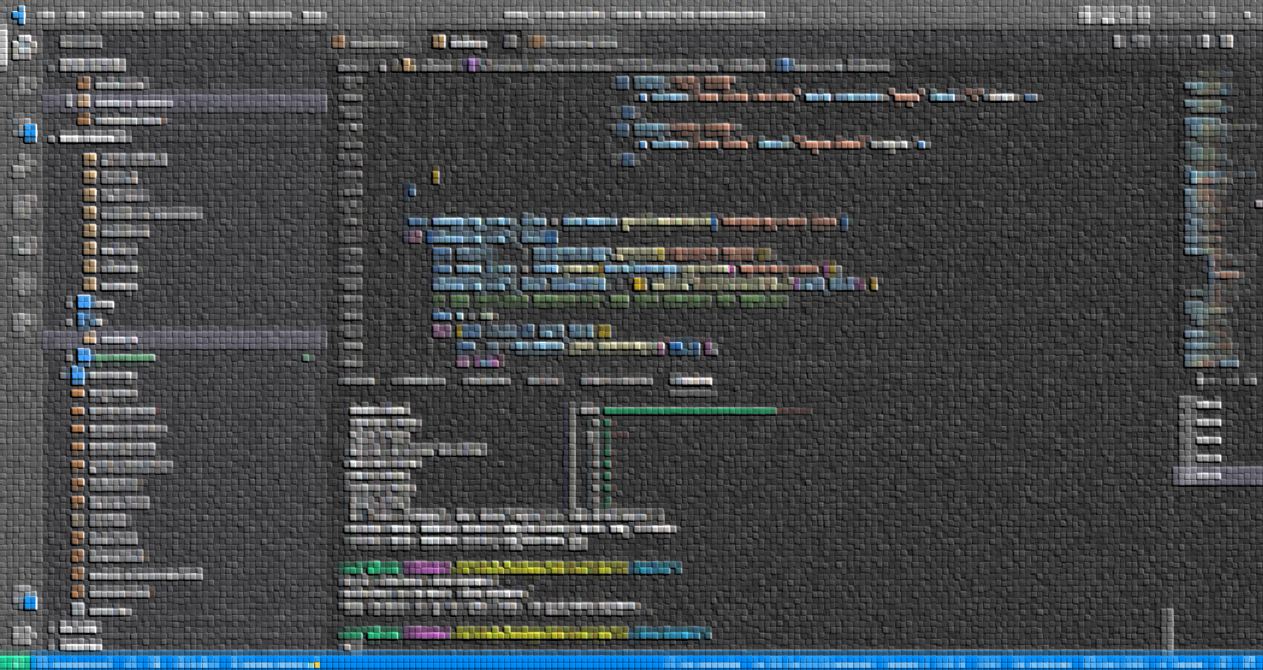
TechnologIES UTILIZED TO IMPLEMENT THE PROJECT

Slide 12





MODEL
JAVASCRIPT OBJECTS
VIEW
HTML, CSS, VANILLA JS, BOOTSTRAP 5
CONTROLLER
VANILLA JAVASCRIPT
Notes:
For the entirety of the project Implementation, I see to it that proper code segregation is adhered. I divided the code into separate file according to its intended function. I prefer clean code personally.
For data modeling mechanism I used javascript object arrays in order to describe the properties of each products, users and products category.
For viewing and visualization, I used the combination of html5, css, and bootstrap. I used vanilla javascript to dynamically render DOMs that relates to the products presentation.
And for basic page routing and business logic obviously I used vanilla JS.

Slide 13








IDE
VS CODE w/ HTML-CSS, TABNINE, LIVE SERVER
VERSION CONTROL
GIT AND GITHUB, MINGW-CLI
WEB SERVICE
XAMPP, GITHUB-PAGES
Notes:
For IDE I used vscode with installed html css javascript code snippets, I also installed live server extension and tabnine for AI driven automatic code completion and intellisense since I did not yet really memorized most of the syntax
For version control, git and github is used together with mingw as the emulation of bash command line interface.
For local web service I used xampp for local test deployent and for online deployment I used github pages.

Slide 14
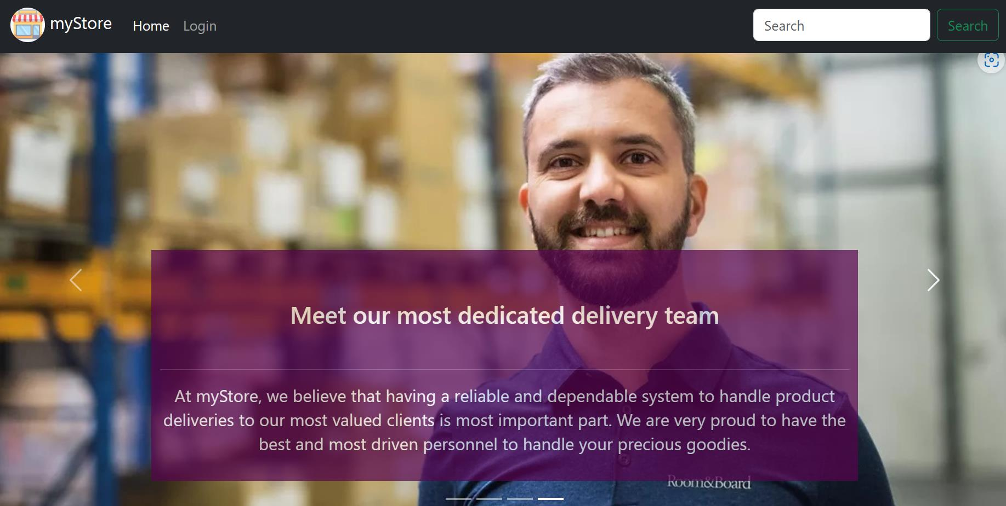
Use case diagram
Notes:
A use case diagram is a visual representation of the functional requirements of a system, which shows the interactions between actors (users, roles, or other systems) and the system itself. Use case diagrams are typically used to describe the high-level functionality of a system and to show how the system interacts with its environment.

Slide 15
myStore Online Shopping System
LOGIN
<<include>>
USER INFO
<<include>>
<<include>>
<<include>>
LOGOUT
REGISTERED CUSTOMER
SHOPPING CART
<<include>>
<<include>>
<<include>>
<<include>>
MAKE PURCHASE
<<include>>
CHECKOUT
VIEW PRODUCTS
<<include>>
NON-REGISTERED CUSTOMER
Notes:
In our case,
2 actors
7 general use cases

Slide 16
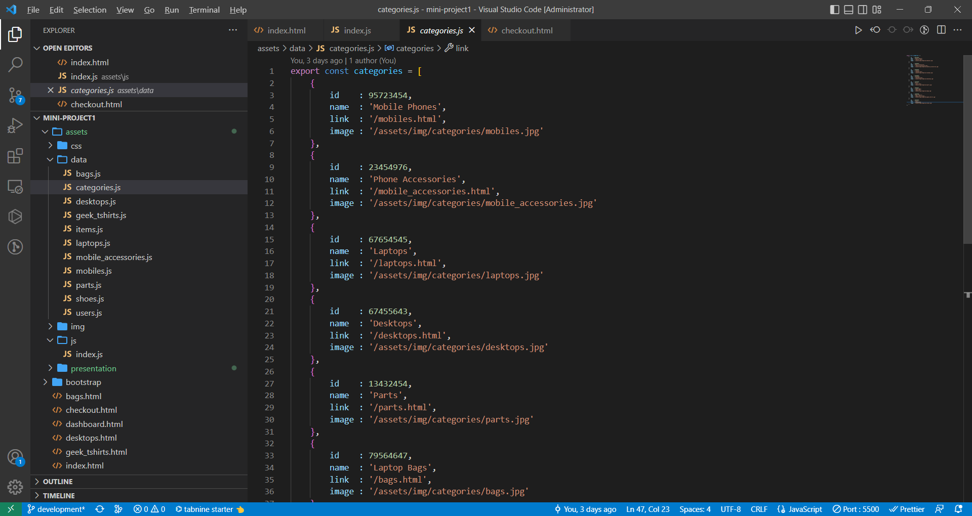
OBJECT MODELS
Notes:
object model defines the classes, objects, attributes, and methods that make up the system, as well as the relationships between them.

Slide 17
PRODUCT_CATEGORY
PRODUCT_ITEM
USER
Id : INT
name : STRING
link : STRING
image : STRING
Id : INT
category_id : INT
on_sale : BOOL
description : STRING
specs : STRING
unit_price : NUM
discount_p : NUM
qty : INT
sold : INT
review_rate : INT
main_image : STRING
images : ARRAY{STRING}
email1 : STRING
password1 : STRING
name : STRING
contact : STRING
address : STRING
img : STRING
cart_list : ARRAY{PRODUCT_ITEM}
upcoming_deliveries: ARRAY{PRODUCT_ITEM}
Notes:
1. Product_category model describes the grouping of each products. It has link property so that whenever the user clicks on the product category item it will be redirected to the appropriate page. The image is the url that represents its thumbnail.
2. Product_item model describes the characteristics of each individual product being presented. On sale marks the products as on a promotional sale,
3. User model describes basic user data which includes the list of products that where sent to the shopping cart and the list of purchased products for delivery

Slide 18


Push mo lang yan te.
Ice breaker
“
“
I CAN’T DO IT, SOOO DARN HARD
-git
-BOOT CAMP GUY

Slide 19
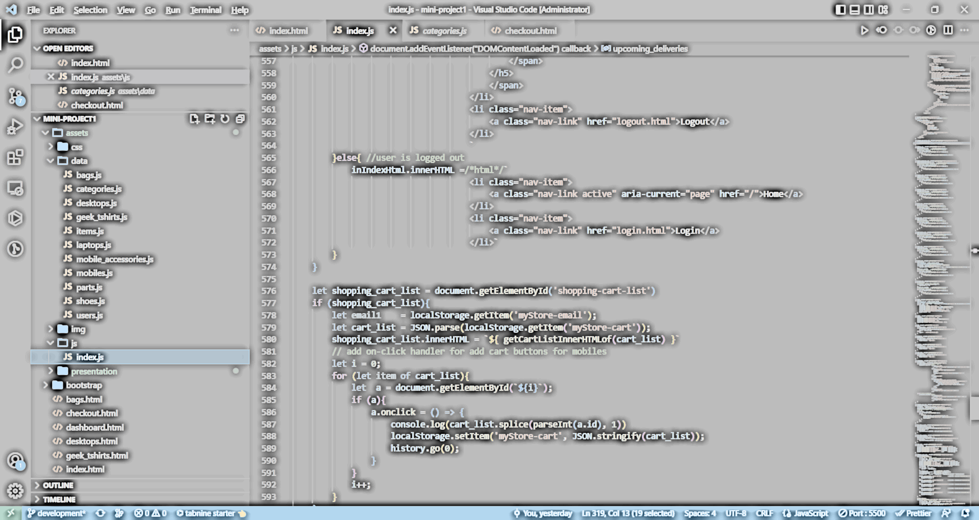
DATA FLOW diagram
Notes:
A data flow diagram (DFD) is a visual representation of how data flows within a system. It shows the inputs, processes, and outputs of a system, as well as the data stores and entities that interact with the system.
The basic components of a data flow diagram include:
Processes: These represent the functions or activities performed within the system. Each process takes inputs, performs some operation, and produces outputs.
Data Flows: These are the paths through which data moves between the different components of the system, such as processes, data stores, and entities.
Data Stores: These are the places where data is stored within the system, such as databases or files.
Entities: These are the external factors that interact with the system, such as users, customers, or other systems.

Slide 20
CUSTOMER
1.2
1.1
PROD SEARCH
ON SALE LIST
D1
LIST OF PRODUCTS
1.0
HOME
D2
LIST OF CATEGORIES
2.0
6.0
LOGIN
CATEGORY LIST
D3
LIST OF USERS
3.0
DASHBOARD
7.0
SHOPPING CART
D3.1
LIST OF SHOPPING CART ITEMS
4.0
3.1
CHECKOUT
INCOMING SHPM
D3.2
LIST OF INCOMING SHIPMENT
5.0
8.0
PAYMENT
myPROFILE
Notes:
Red rectangle represent an external system ( a human being behind a computer, a web scraper, or a web crawler)
Blue bubbles represents sub system being used by the web app
Green rectangle represent the data sub system

Slide 21



Road map
backend
Product delivery monitoring
User registrar
Integrate transaction data to a database
Credit card payment integration using STRIPE or PAYPAL
Implement dynamic user registration
Log of product delivery status must be implemented
Dynamic updating of products by the seller

Slide 22
Designing and implementing a simple static online shopping system in spite of yet limited time and lack of experience is challenging but doable and rewarding enough
summary

Slide 23
THANK YOU
Garry M. Cacho
gc120978levelup1@gmail.com
www.garrymcacho.com

